Slide 1





LIBRARY MANAGEMENT SYSTEM
Name: Shihab Howlader
ID: 232-35-203

Slide 2



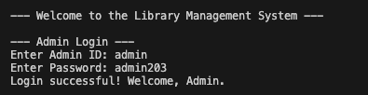





Slide 3
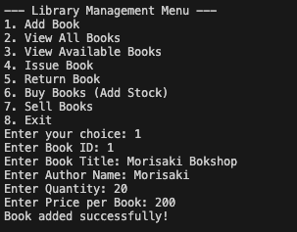

Slide 4
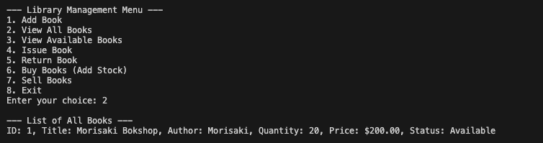

Slide 5

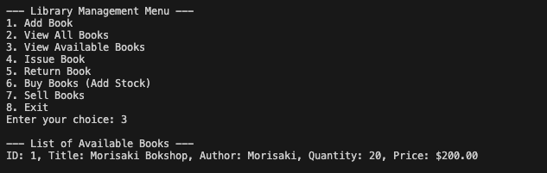



Slide 6
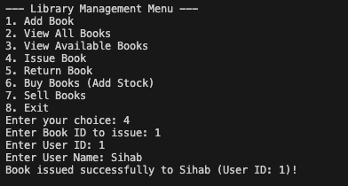

Slide 7
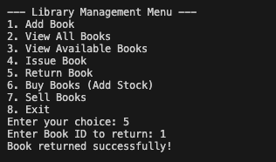

Slide 8
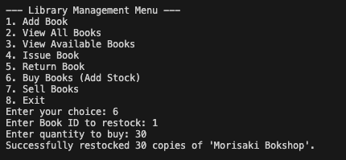

Slide 9
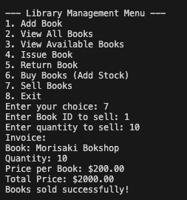

Slide 10
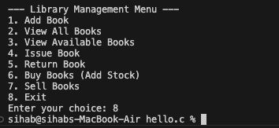

Slide 11

ANY QUESTIONS?

Slide 12
THANK YOU!!

